Slide 1

DBMS PROJECT REVIEW-1
Adithi Giridharan (18303)
Aishwarya Babu (18304)
Akhila Kolli (18333)
DBMS PROJECT REVIEW-1
SMART TIME TABLE GENERATOR

Slide 2
Introduction
Abstract
Logical Database Design - ER Diagram
Entities
Attributes
Relationships
ER to Relational Schema Mapping
User Interface Screenshots
References
OVERVIEW

Slide 3
OBJECTIVE
To create an online platform to ease the tedious work of creating a timetable system to facilitate dynamic addition of classes and substitution of professors on their absence.

Slide 4
ABSTRACT
Smart Timetables helps education providers deliver more value to students and keep admin costs down, even as student numbers grow.
It does this by automating the delivery of up-to-date, personalized timetables – enriched with information such as professor availability, assignment due dates and tutorial reminders – directly into the phone and tablet calendars of students and staff.

Slide 5
ABSTRACT
It also enables staff to manage their timetables and deal with clashes or other issues straight away. This makes things simpler and easier for them, and helps to reduce their admin burden.
There are many situations where a particular period might be wasted because of the absence of a professor. This Smart Time Table ensures that a substitute professor is notified to take over the class.

Slide 6
BUSINESS RULES
Separate timetable for the individual class, faculty and labs are to be generated automatically by this system.
Slot clashes do not occur.
Faculty replacement is also to be made possible by listing out the available faculty who are eligible to be assigned as temporary faculty until a replacement faculty is assigned.

Slide 7



DATABASE
SOFTWARE USED
UI DESIGN

Slide 8
OUTPUT
Users can view Class, Teacher and Lab Timetables.
Faculty members can apply for changes and request for replacement.
Compensation classes can be organized and the updates regarding the same will reach to all concerned users

Slide 9
WHAT WE HAVE DONE
ER Diagram
Abstract
Schema Diagram
Basic UI

Slide 10
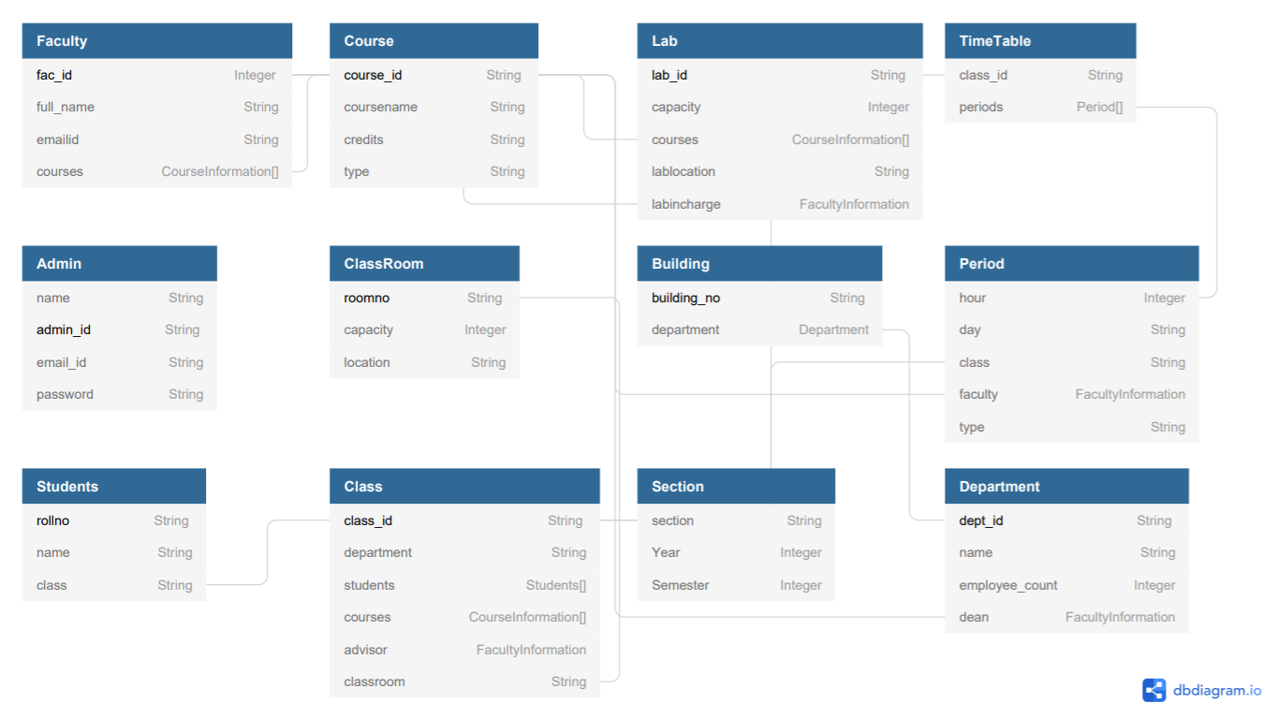
SCHEMA
DIAGRAM

Slide 11
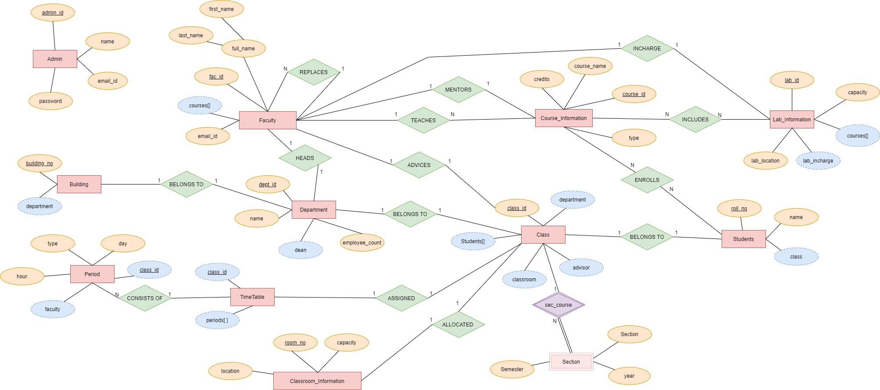
ER DIAGRAM
Entity
Attribute
Derived Attr.
Relationship
Identifying Relationship

Slide 12

ER DIAGRAM ENTITIES
Faculty
Course
Lab
ClassRoom
Period
Department
Building
Students
TimeTable
Class
Section
Admin

Slide 13
ER DIAGRAM - ATTRIBUTES
Faculty - fac_Id, full_name (F_name,L_name), email_Id, courses[ ]
Course – course_Id, course_name, credits, type
Lab – lab_Id, capacity, lab_location, lab_incharge, courses[]
ClassRoom_Information– room_no,capacity, location
Period – hour, day, class_id, faculty, type
Department - dept_id, name, employee_count, dean
Building - building_no, department
Students – roll_no, name, class
TimeTable – class_id, periods[ ]
Class – class_id, department, advisor, classroom, students[]
Section – section, year, semester
Admin – name, admin_Id, email_id, password

Slide 14
ER DIAGRAM - RELATIONSHIPS
Replaces - faculty_id, faculty_replacements[ ]
Mentors - course_id, faculty_id
Teaches - course_id, faculties[ ]
Includes - course_id[ ], lab_id[ ]
Enrolls - student_id[ ], courses[ ]
Heads - dept_id, faculty_id
Belongs_to - class_id, dept_id
Consists_of - periods[ ], timetable
Assigned - timetable, class_id
Allocated - class_id, room_no
Advices - faculty_id, class_id
Incharge - faculty_id, lab_id

Slide 15
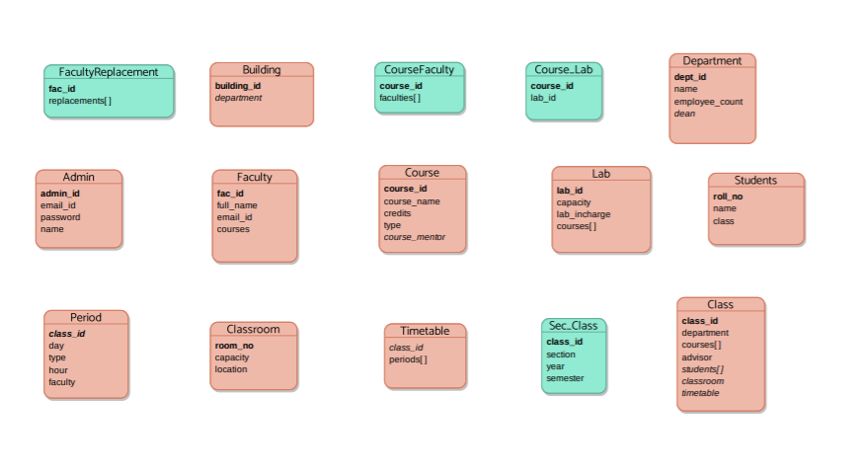
ER TO RELATIONAL SCHEMA MAPPING

Slide 16
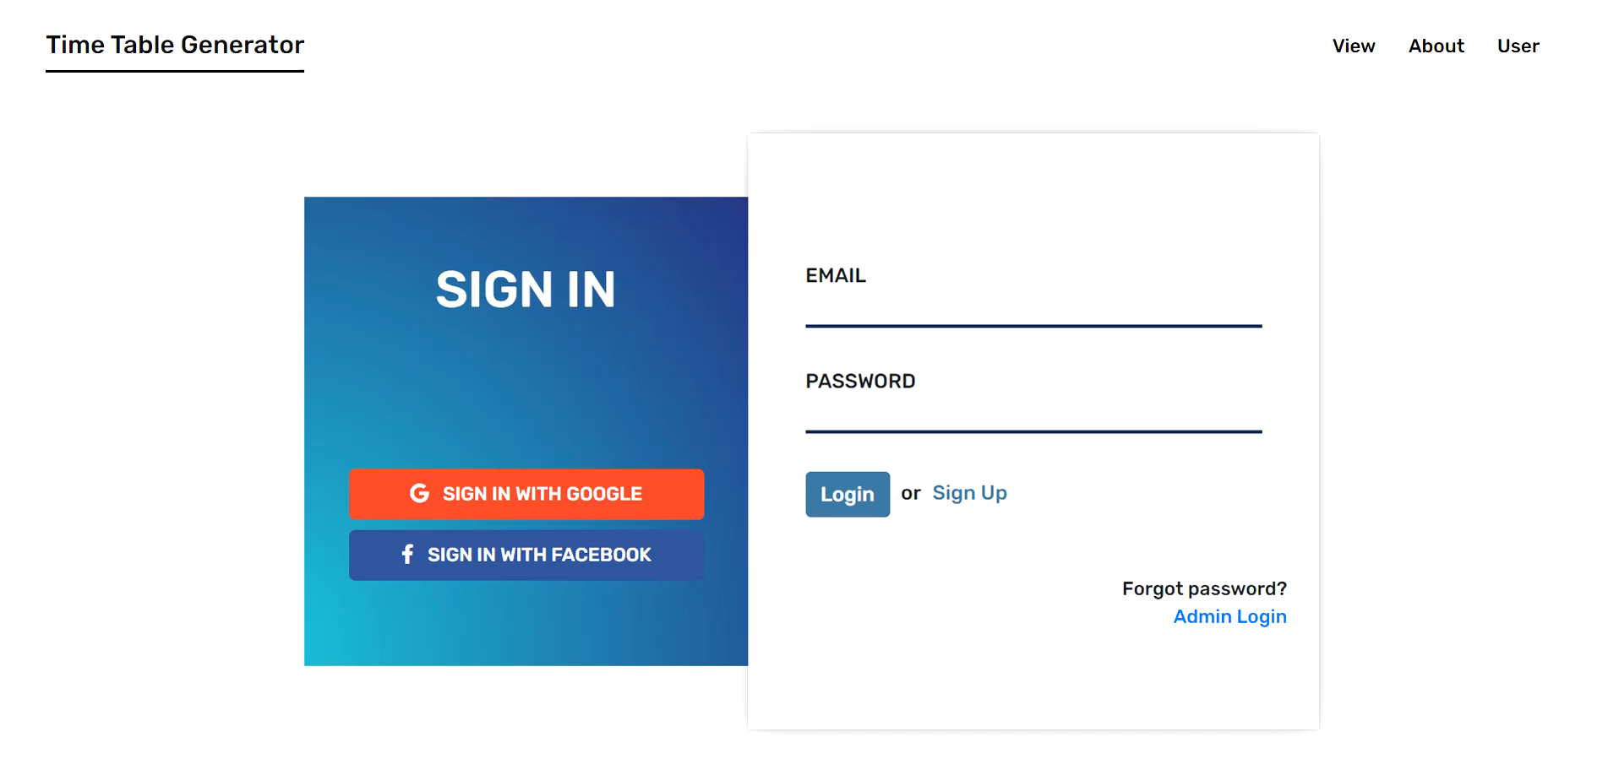
USER INTERFACE

Slide 17
REFERENCES
Hector Garcia-Molina, Jeffrey D Ullman, “Database System: The complete book”, 2nd edition, 2011.
App.diagrams.net
dbdiagram.io

Slide 18
THANK YOU

